Slide 1
Travel Recommendation Exercise
Capstone presentation

Slide 2
Recommendation services are key to BeGone International
Increase reader/traveler engagement from its outlet across its new and existing user base
Increase recommendation services from BeGone International
Marketing of local and destination venues
Demonstration of data analytic capabilities

Slide 3
Data
For this initiative, The research resources are using location using Python libraries and venue data from publically accessible form from FourSquare. From this data source, data on New York City and Toronto venues was acquired.
Venue information within the vicinity of the neighborhoods was retrieved using the Foursquare location API. Maps and graphs were generated using Python libraries to visualize the location and venues nearby
Anomalies in data were excluded, i.e. venues without valid postal codes
Mail codes removed from Toronto postal codes, as they did not inform or add value to the initiative

Slide 4
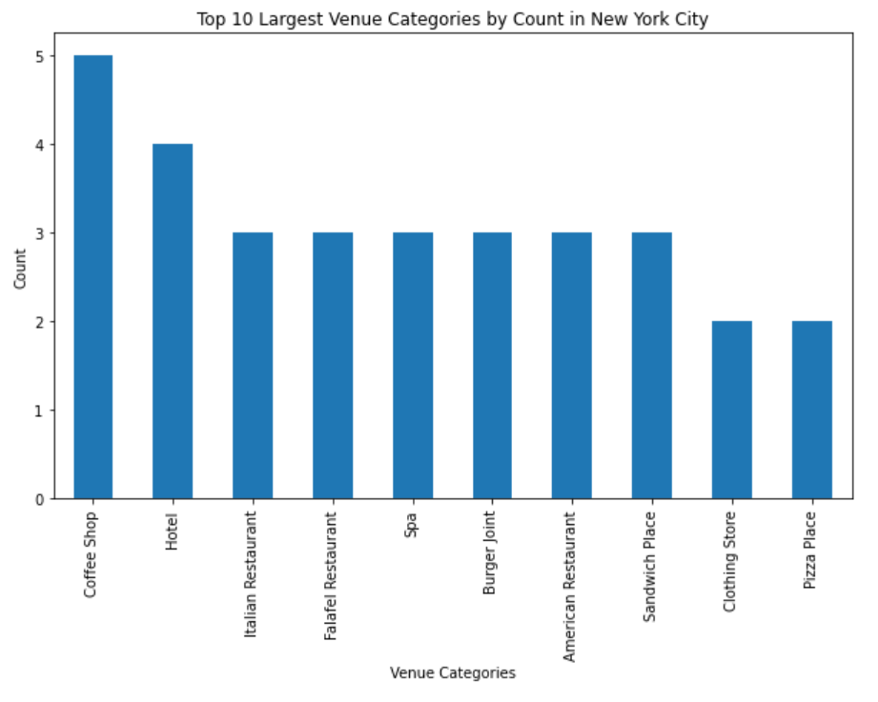
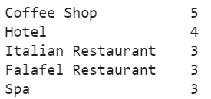
Statistical Analysis on Source Data

Slide 5
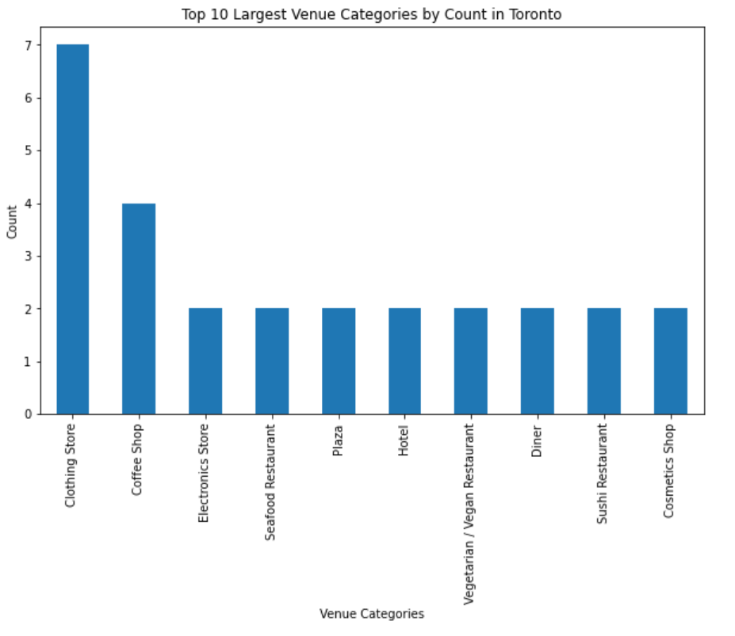
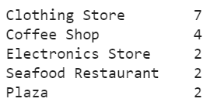
Statistical Analysis on Source Data

Slide 6
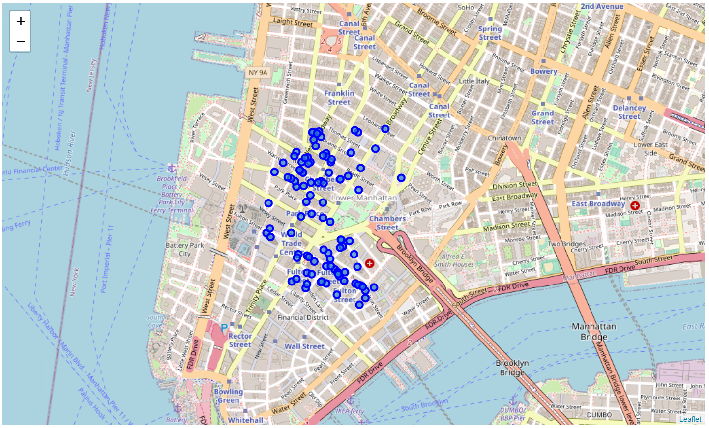
Map of New York City, NY
100 venues were selected with 500 meters of New York City
100 venues were assessed
4 zip codes were captured

Slide 7
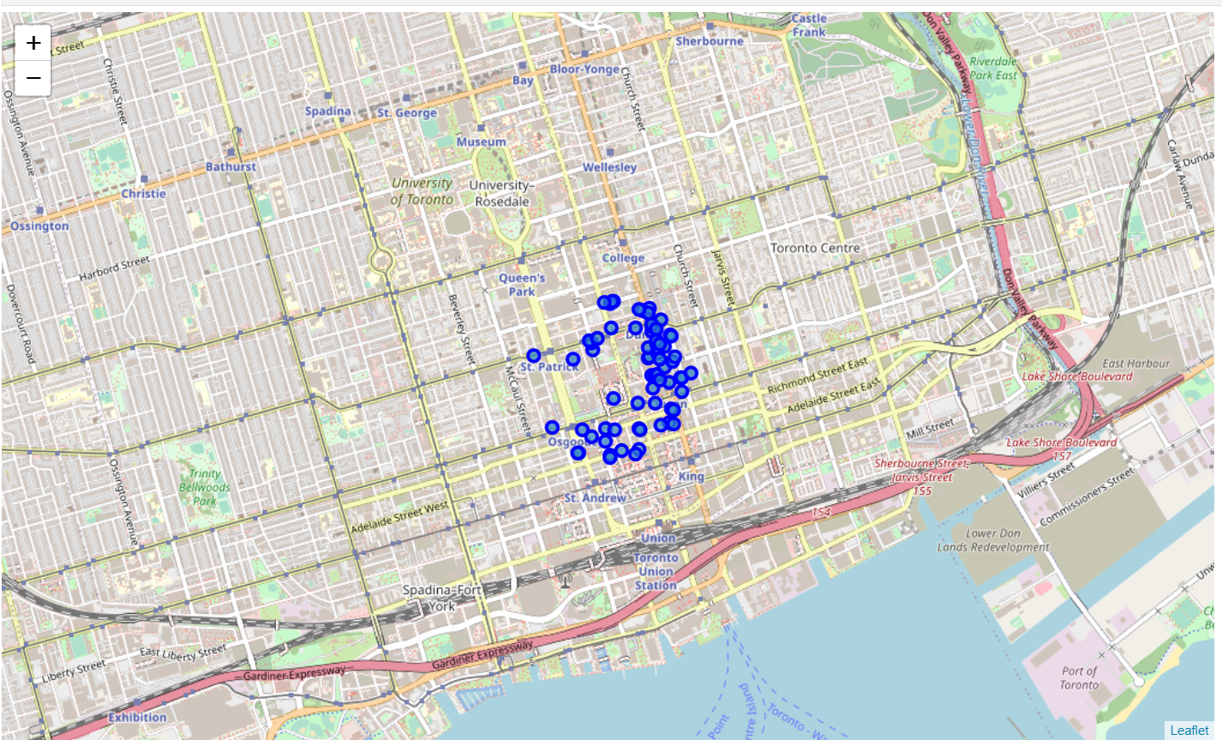
Map of Toronto, Canada
100 venues were selected with 500 meters of New York City
78 venues were assessed
7 zip codes were captured

Slide 8
Data
The use of the FourSquare data on venues within New York and Toronto required the following maintenance, in order to execute this initiative:
Removal of Toronto venues with Null postal codes, from the any further processing or analysis
Re-formatting of the Toronto postal codes, to remove trailing mail delivery codes

Slide 9
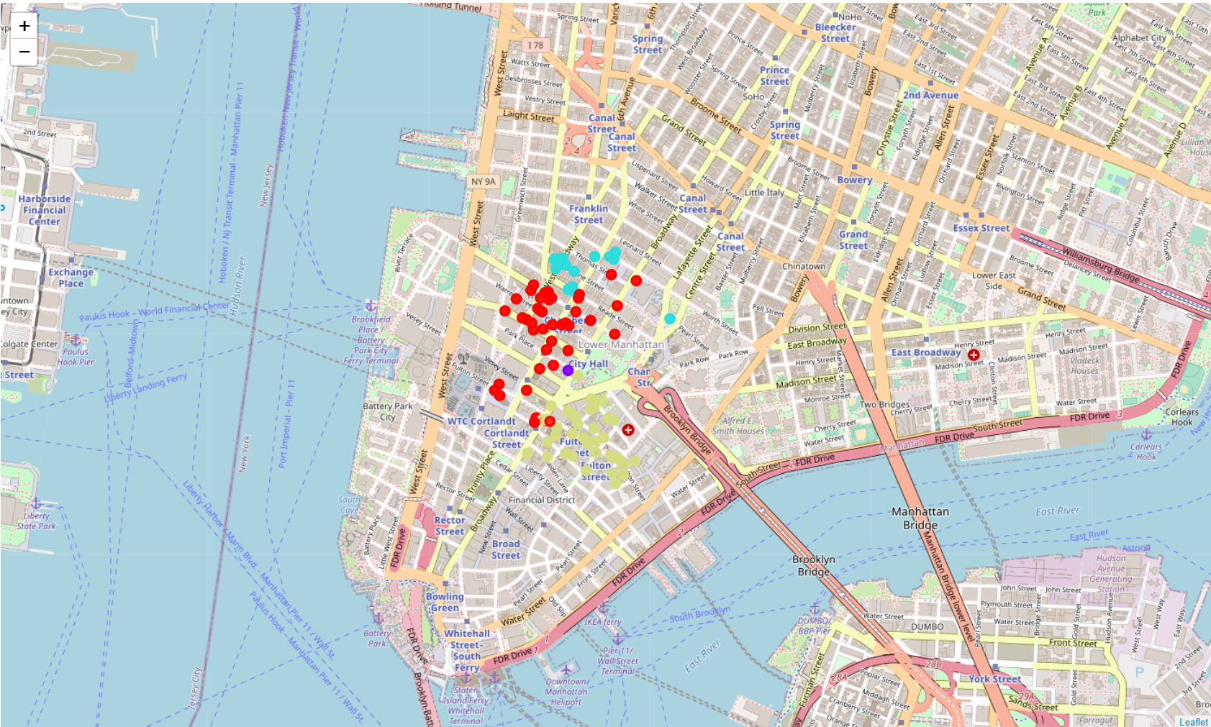
Clustering of New York City venues
Using the 1st most common venue category for each cluster:
Cluster 0 – Coffee Shop
Cluster 1 – Building
Cluster 2 – Sushi Restaurant
Cluster 3 – Sandwich Place

Slide 10
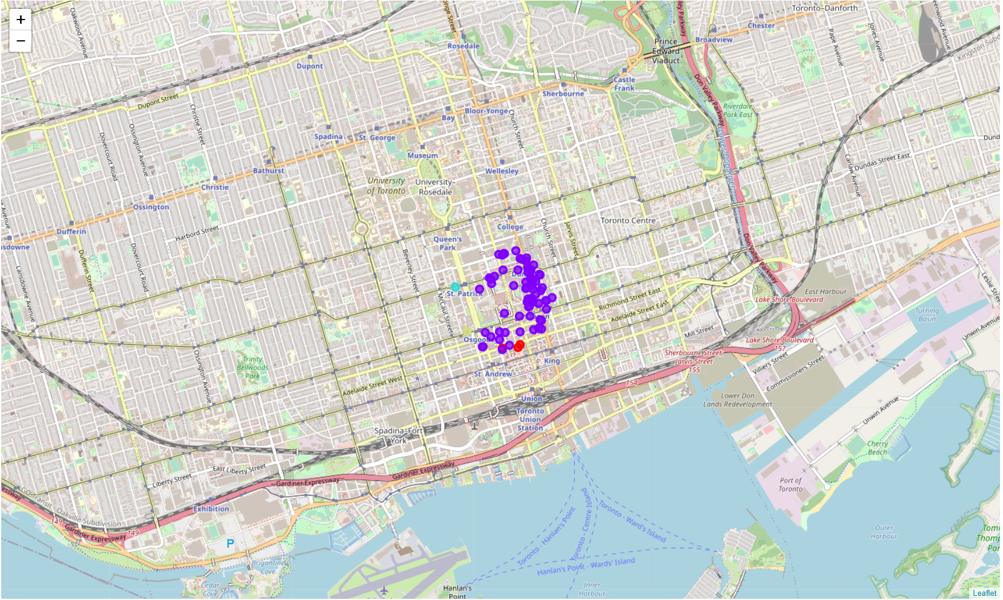
Clustering of Toronto venues
Using the 1st most common venue category for each cluster:
Cluster 0 – American Restaurant
Cluster 1 – Clothing Store
Cluster 2 – Cafe
Cluster 3 – Coffee Shop

Slide 11
Results
Using categorical attributes, specifically the venue type, the data set on venues had to be transformed. Those attributes were converted into frequency of occurrence of a venue category across a postal code for both New York City and Toronto
Using k-means (N=number of postal codes per location), those postal codeswere associated or clustered based on the highest frequency of venue categories in that location
The cluster of zip codes was generated based most common venue category (with the highest frequency)
Visualizations were created to demonstrate venue’s location within those postal code and venue clusters in both New York City and Toronto
Refer to the resulting dataframes

Slide 12
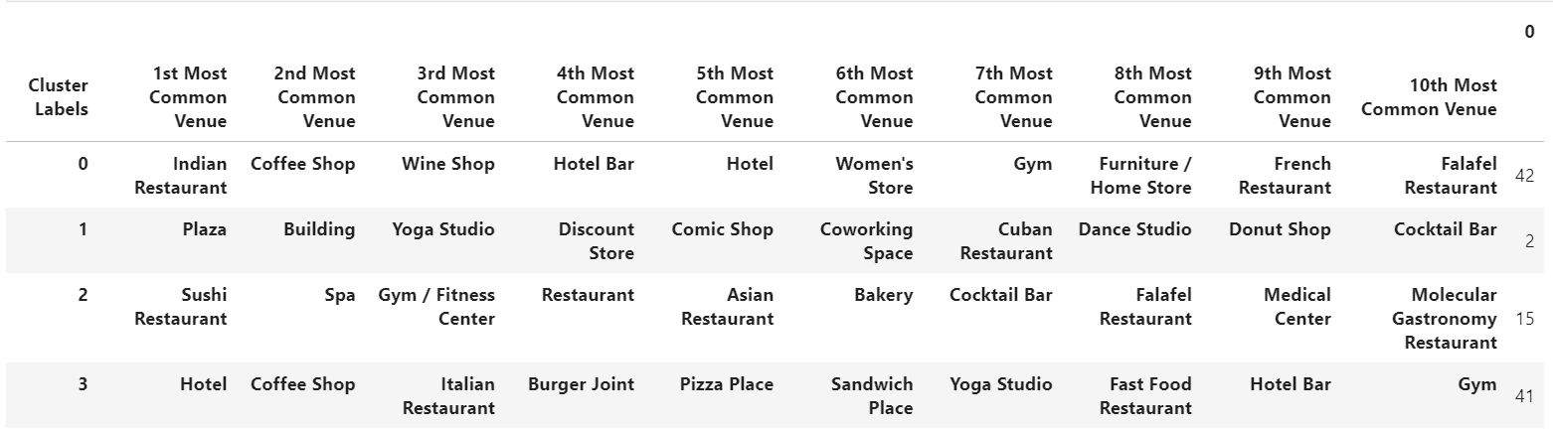
New York City

Slide 13
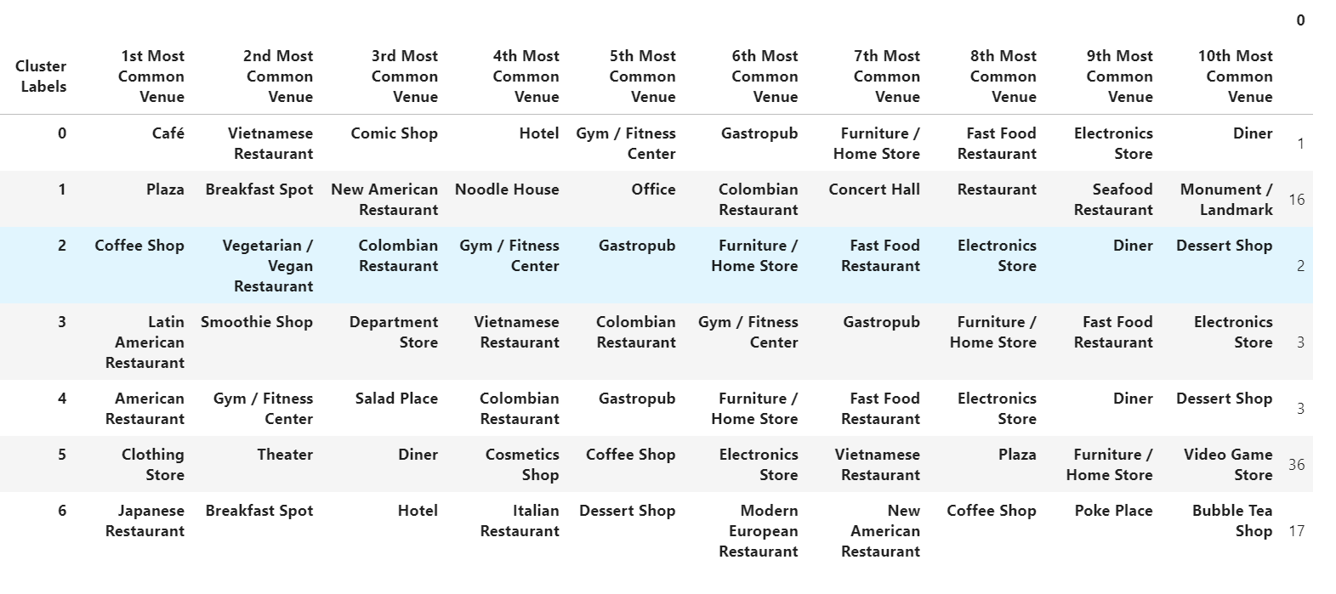
Toronto

Slide 14
Observations
Based on the research findings,
Coffee Shops was the most common venue out of the top 10 categories within the locations Toronto and New York City.
4 zip codes were assessed in New York City and 42 zip codes were assessed in Toronto
100 venue were assessed in New York City and 68 venues were assessed from Toronto, showing that data set from Toronto had discrepancies
These categories are the first most common venue category. The analysis is supported based on the count of venue categories captured in the provided bar graphs

Slide 15
Conclusion
The use of clustering for generating recommendation services should be proposed for further investment and/or evaluation given the overlap in identified venue types
Using a larger data set or data with missing values. This impacts number of venues and frequency of venue categories available to be evaluated.

